Slide 1


Family-Centric Government
Scheme Eligibility application
Hackathon Project
Smart Governance using Technology

Slide 2

Problem Statement
Citizens lack awareness of age-based government schemes
Basic Required documents for a Person which may vary by age
Where the Information’s (Schemes/Scholarships…) are spread across multiple portals

Slide 3

Proposed Solution
A single centralized platform that provides age-based government schemes and services
Family login using Ration Card, allowing access to all family members in one place
Automatic age calculation using Date of Birth (DOB) to identify eligibility
Shows eligible government schemes, scholarships, and services in one dashboard
Provides official application links and guidance, reducing dependency on multiple portals

Slide 4
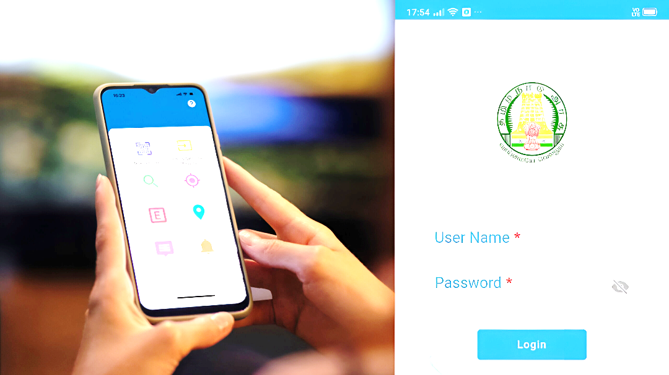
How It Works
Login using Ration Card via OTP
View family members
Click member → View schemes & documents
Displaying Eligible Government Schemes/Scholarship’s
Guiding application links for Required documents based on User Age

Slide 5
Key Features
Family members can access only via registered mobile number OTP
Age-based eligibility engine
Centralized government information
Easy-to-use Application
Ensures High level Encryption
Preventive awareness
Automatic Scalable for future schemes

Slide 6
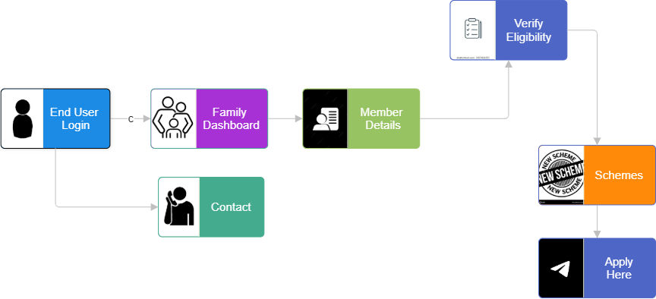
User Flow

Slide 7
Technological Stack
Backend: Node.js / Python
Frontend: Flutter(Multi-Platform Functionality)
Database: PostgreSQL
APIs: REST

Slide 8

Conclusion
One platform to guide every citizen on “what they are eligible for and when to apply”
Thank You

